Slide 1
Renewable Energy

Slide 2
Renewable energy is energy which comes from natural resources such as sunlight, wind, rain, tides, and geothermal heat, which are renewable (naturally replenished). New and renewable sources of energy have received a great deal of attention since the World Summit on Sustainable Development. Solar, wind, and hydroelectric power not only produce minimal carbon emissions once the generating systems are in place, they also help reduce poverty through improved energy access in underserved areas. The World Energy Assessment has defined "sustainable energy" as energy produced and used in ways that support human development over the long term in all its social, economic and environmental dimensions. It concluded that the adoption of new policies that encourage the delivery of energy services in cleaner and more efficient ways is a prerequisite to address current development problems. The World Energy Assessment showed that by acting now to embrace these policies, a more equitable, economically prosperous, and environmentally sound world is within our reach. In 2010, about 20 % of global final energy consumption came from renewable.
Overview of Capacities for Renewable Energies

Slide 3
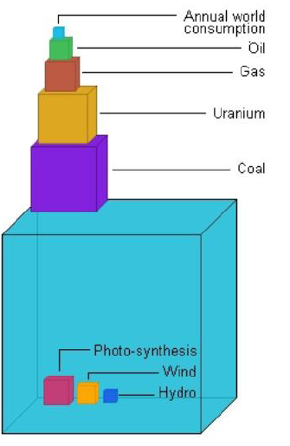
Overview of Capacities for Renewable Energies
Fossile and uranium are small & limited
compared to renewable energies as solar

Slide 4
Facts about Solar
The Sun - A fascinating energy source
Age of the sun: app. 5 billion years
Estimated lifetime: app. 4,5 billion years
Temperature (inside the sun): 16.000.000°C
Irradiation on earth: 1.524.240.000.000 TWh/year
Consumption Kuwait: 45 TWh/year
The sun sends world energy need in 3,5 hrs. !

Slide 5
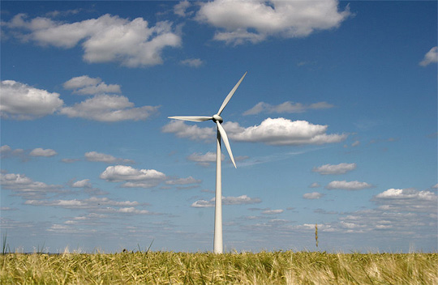
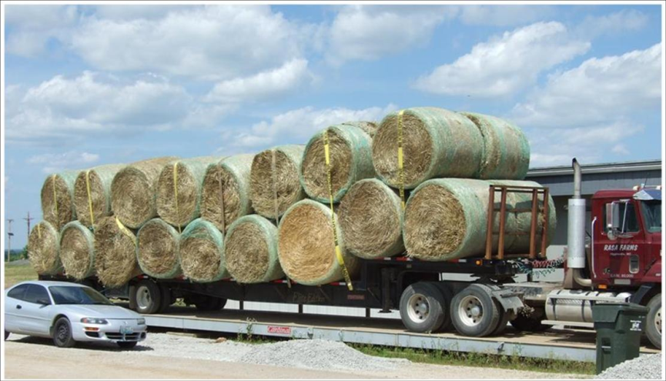
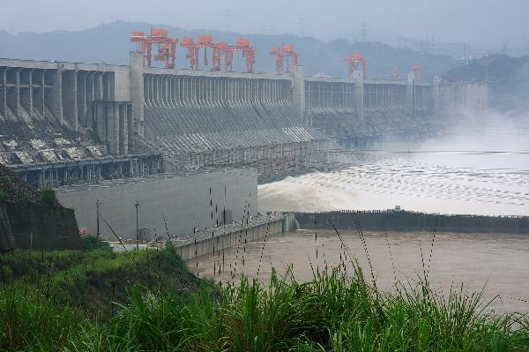
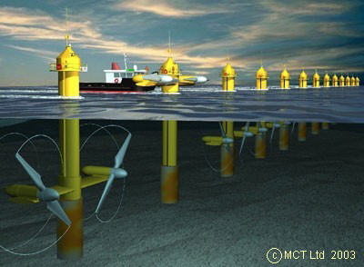
Renewable Energy Production
Solar Energy / Photovoltaics PV
Wind Energy
Bio Mass
Water Energy

Slide 6
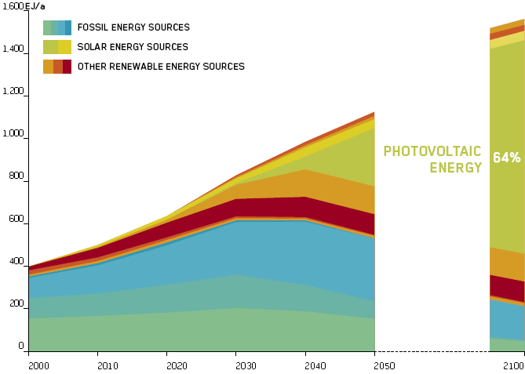
Solar Energy: Highest potential of Renewable Energy
„While fossil fuels are being exhausted at an alarming pace, global energy consumption continues to increase. The solution, however, has always been around. We only need to connect our grid to the sun.“
UNO Secretary-General Ban Ki-moon
German Advisory Council on Global Change (WBGU) estimates a major reduction in the use of fossil energy by the year 2100 and a substantial development and expansion of new renewable energy sources, notably solar.

Slide 7
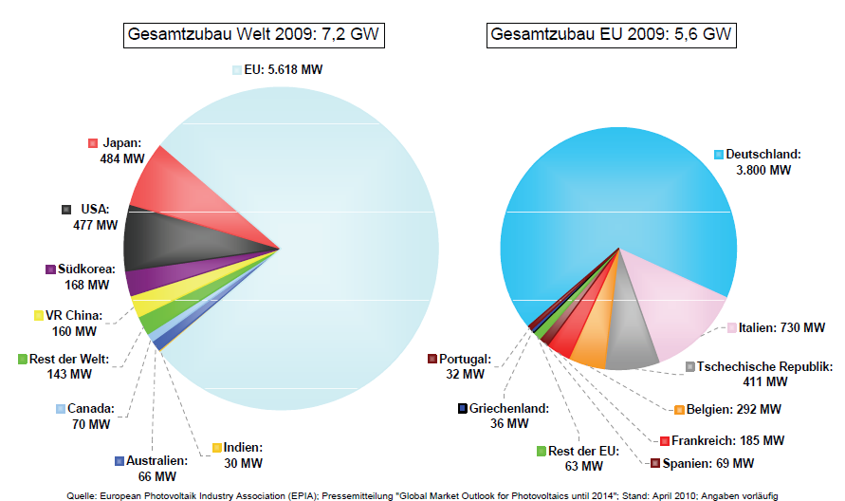
New Installations for photovoltaic energy in 2009
Worldwide installations 2009: 7,2 GW
EU installations 2009: 5,6 GW
ESTIMATION FOR 2010: 13,6 GW

Slide 8
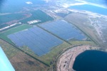
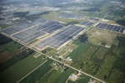
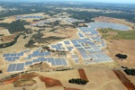
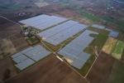
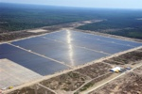
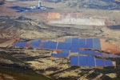
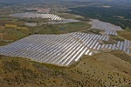
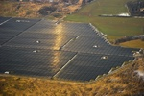
TOP 10 World-largest Photovoltaic Installations
1. | 80.7 MW | Germany, Finsterwalde | Solarpark Finsterwalde I,II,III | 2009-2010
2. | 80 MW | Canada, Sarnia (Ontario) | Sarnia PV power plant | 2009-2010
3. | 70 MW | Italy, Rovigo | Rovigo PV power plant | 2010
4. | 60 MW | Spain, Olmedilla | Parque Fotovoltaico Olmedilla de Alarcón | 2008
5. | 54 MW | Germany, Straßkirchen | Solarpark Straßkirchen | 2009
6. | 53 MW | Germany, Turnow-Preilack | Solarpark Lieberose | 2009
7. | 50 MW | Spain, Puertollano | Parque Fotovoltaico Puertollano | 2008
8. | 46 MW | Portugal, Moura | Moura photovoltaic power plant | 2008
9. | 45 MW | Germany, Köthen | Solarpark Köthen | 2010
10. | 40 MW | Germany, Brandis | Solarpark Waldpolenz | 2007 2008

Slide 9
Worldwide Use of Solar Energy in 2010
Solar Installations worldwide
X
Kuwait

Slide 10
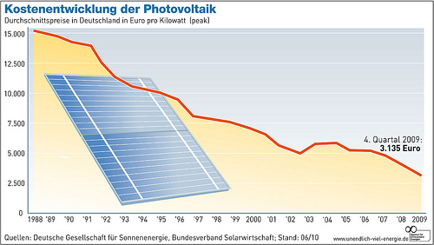
Cost for Solar Electricity is decreasing
Cost of installed Solar Electricity (PV) in Germany in €/kWp
Recent developments:

Slide 11
Investment & Costs for Solar Electricity (PV)
 | 2010 single | 2010 all-incl. | 2015 single | 2015 all-incl.
Investment Production Capacity (Mio € / MWp) | 2,00 | 1,75 | 1,60 | 1,40
Production Costs for Installation (€/Wp) | 0,90 | 0,88 | 0,75 | 0,68
Cost per kWh in Kuwait *) (€/kWh) | 0,126 € | 0,121 | 0,111 | 0,092
*) estimation incl. 2.200kWh/kW; 20 year lifetime; 1% insurance and other costs

Slide 12
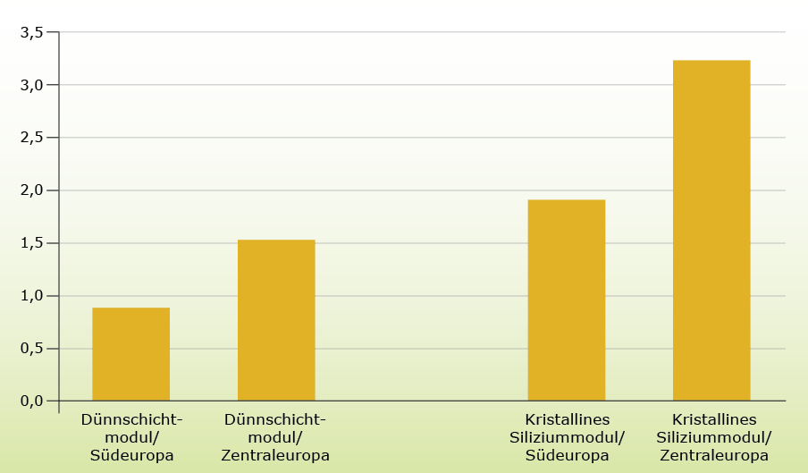
Energy Payback Time of Solar Electricity (PV)
Years
KUWAIT
TF Solar Module
South Europe
TF Solar Module
Central Europe
TF Solar Module
South Europe
C-Si Solar Module
Central Europe

Slide 13
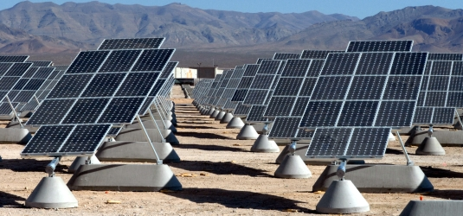
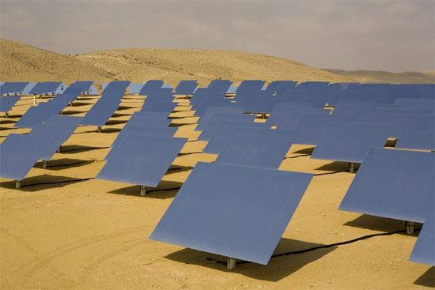
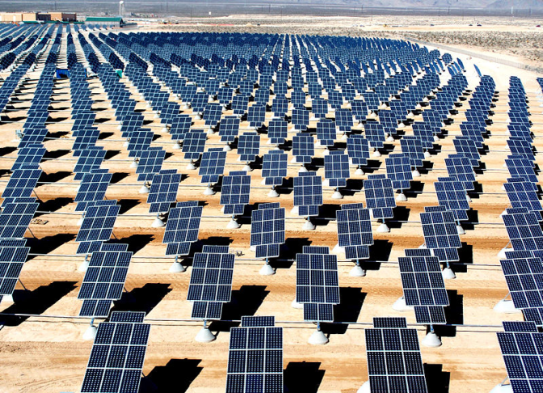
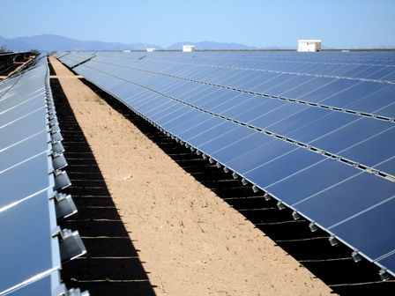
Potential Solar Electricity Production in Kuwait
Large-scale solar installations

Slide 14
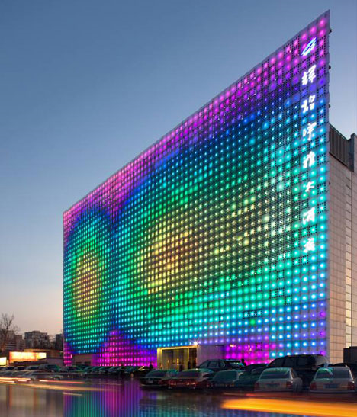
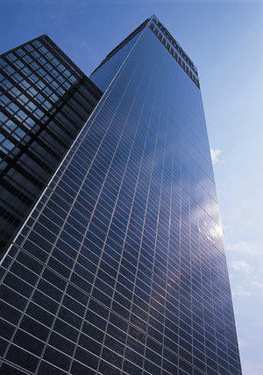
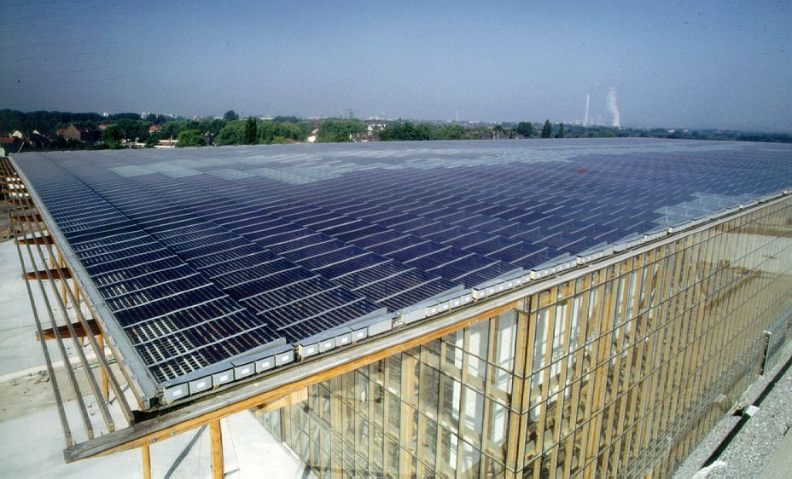
Potential Solar Electricity Production in Kuwait
Building-Integrated solar installations

Slide 15
100% Solar Electricity (PV) for Kuwait / Estimation
Existing Electricity Consumption: 45 TWh
Existing installed Power Utilities: 11 GW
PV Installations needed: 20 GW
Land Area needed: 482 km² (2,7% of total)
Estimated Lifetime: 30 years
Total Electricity Production: 1.320 TWh
Cost per kWh (start): 0,07 €
Cost per kWh (after interest): 0,04 €
Total Investment Costs: 2,6 billion € (after 20 yrs)
5,8 billion € (after 12 yrs)

Slide 16
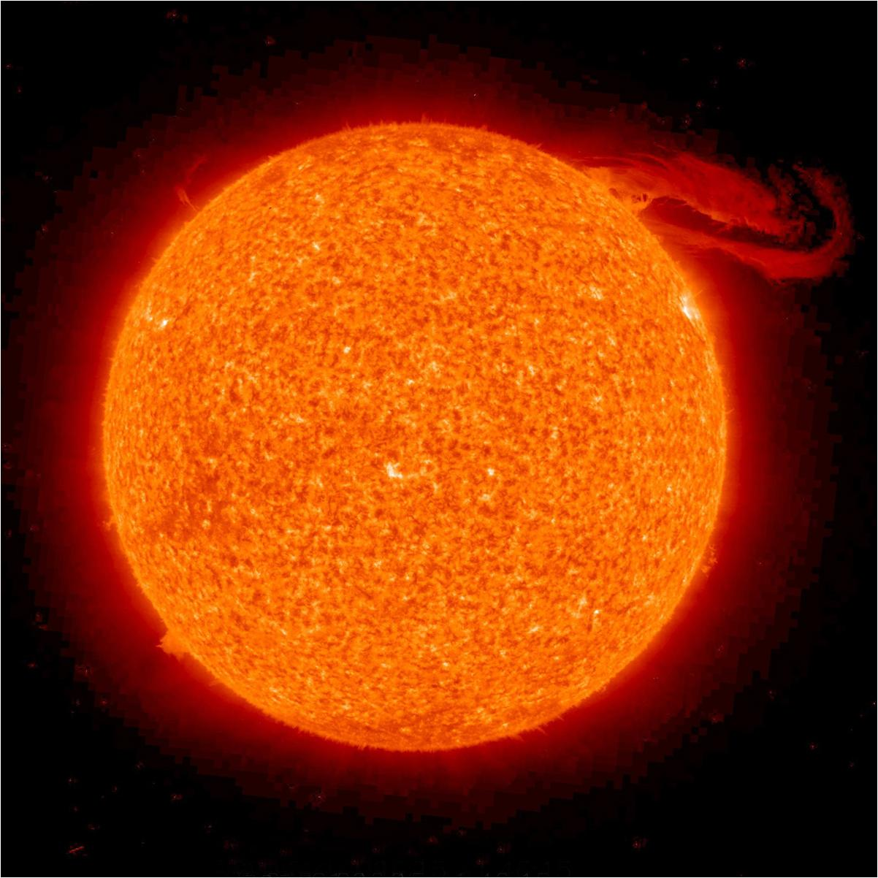
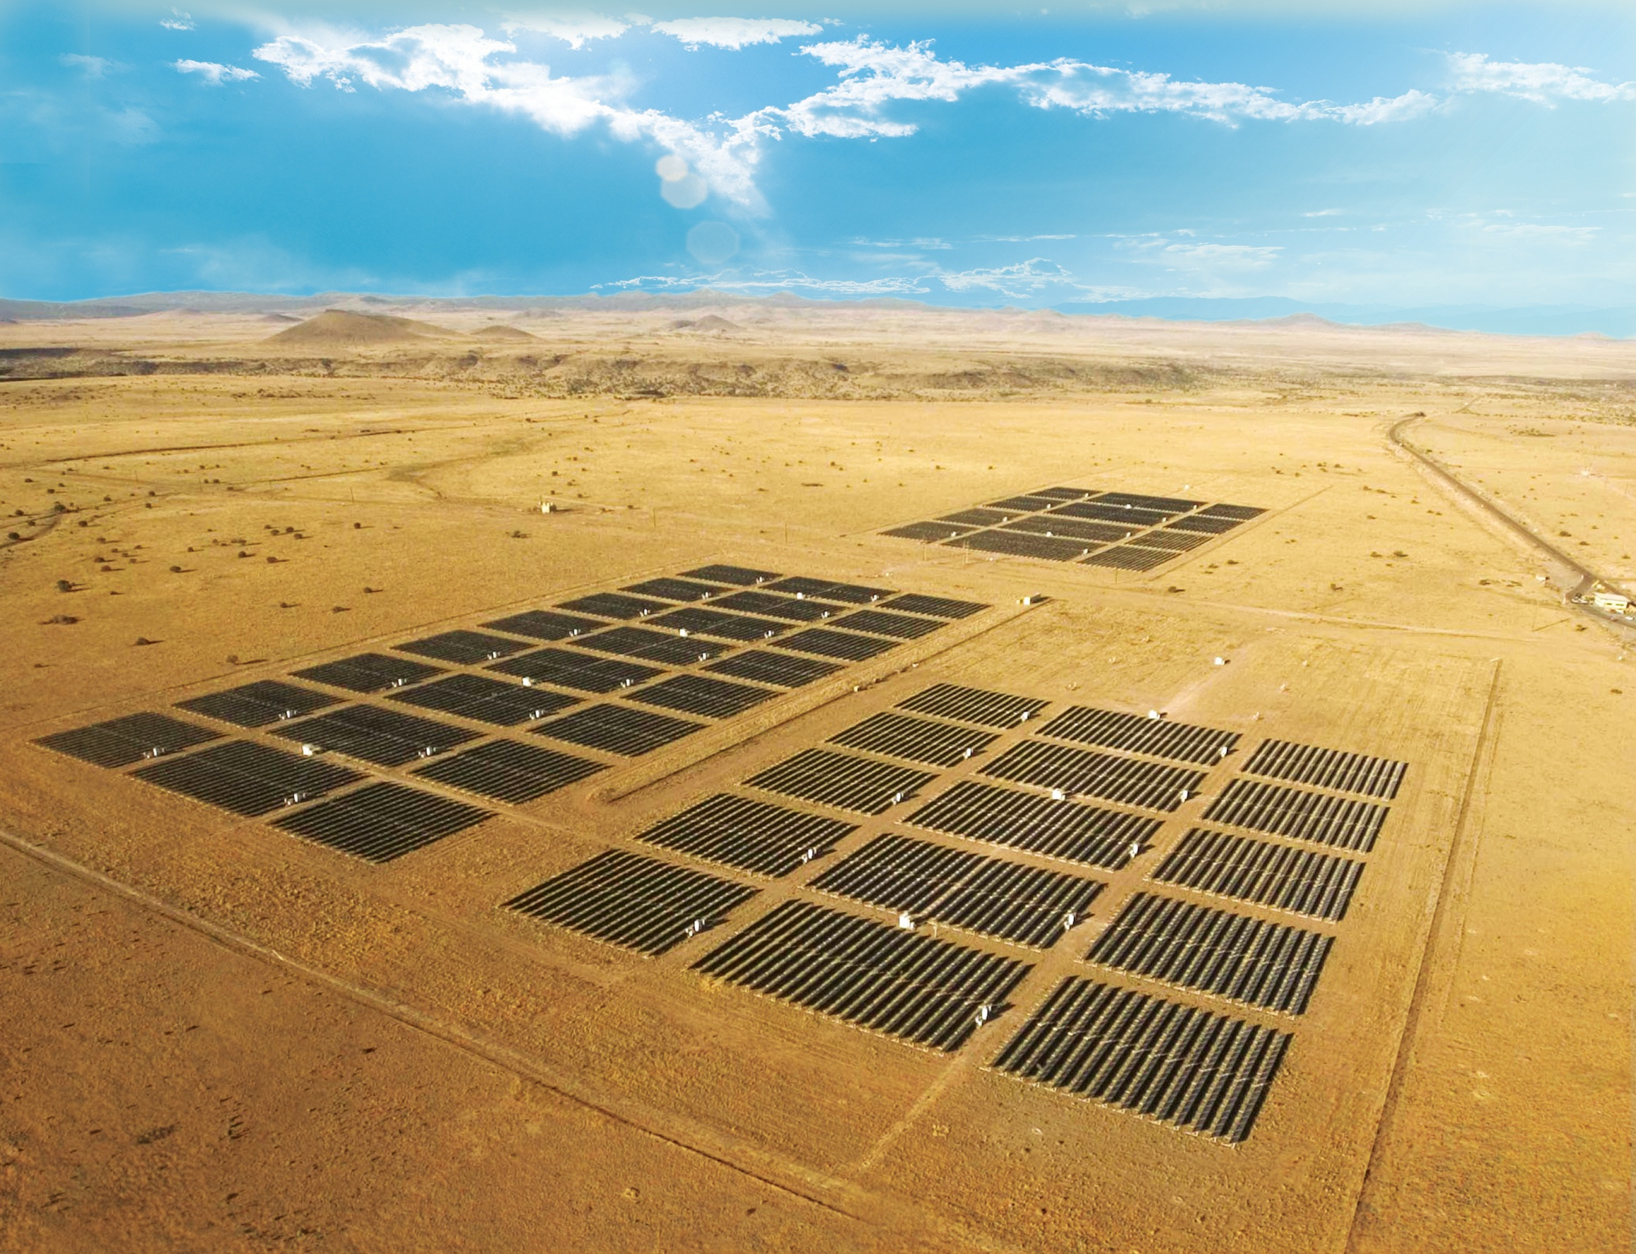
The Sun is our History
and our future
Hermann Scheer – German Solar Pioneer

Slide 17
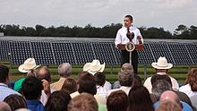
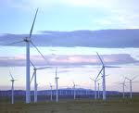
Due to the growing demand for renewable energy sources, the manufacture of solar cells, photovoltaic arrays and wind power has advanced. Photovoltaics (PV) is a method of generating electrical power by converting solar radiation into direct current electricity using semiconductors that exhibit the photovoltaic effect. As of 2010, solar photovoltaics generates electricity in more than 100 countries and, while yet comprising a tiny fraction of the 4800 GW total global power-generating capacity from all sources, is the fastest growing power-generation technology in the world. Wind power is the conversion of wind energy into a useful form of energy, such as using wind turbines to make electricity, wind mills for mechanical power, wind pumps for pumping water or drainage, or sails to propel ships.

Slide 18
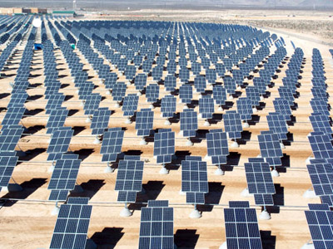
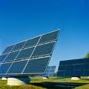
Photovoltaic market Main article: List of photovoltaic power stations 40 MW PV Array installed in Waldpolenz, Germany Photovoltaic production has been increasing by an average of some 20 percent each year since 2002, making it a fast-growing energy technology. At the end of 2009, the cumulative global PV installations surpassed 21,000 megawatts. As of September 2010, the largest photovoltaic (PV) power plants in the world are the Sarnia Photovoltaic Power Plant (Canada, 80 MW), Olmedilla Photovoltaic Park(Spain, 60 MW), the Strasskirchen Solar Park (Germany, 54 MW), the Lieberose Photovoltaic Park(Germany, 53 MW), the Puertollano Photovoltaic Park (Spain, 50 MW), the Moura Photovoltaic Power Station (Portugal, 46 MW), and the Waldpolenz Solar Park (Germany, 40 MW). Many of these plants are integrated with agriculture and some use innovative tracking systems that follow the sun's daily path across the sky to generate more electricity than conventional fixed-mounted systems. There are no fuel costs or emissions during operation of the power stations. However, when it comes to renewable energy systems and PV, it is not just large systems that matter. Building-integrated photovoltaics or "onsite" PV systems use existing land and structures and generate power close to where it is consumed.

Slide 19
Economic trends All forms of energy are expensive, but as time progresses, renewable energy generally gets cheaper, while fossil fuels generally get more expensive. Many organizations have explained that renewable energy technologies are declining in price for three main reasons: First, once the renewable infrastructure is built, the fuel is free forever. Unlike carbon-based fuels, the wind and the sun and the earth itself provide fuel that is free, in amounts that are effectively limitless. Second, while fossil fuel technologies are more mature, renewable energy technologies are being rapidly improved. So innovation and ingenuity give us the ability to constantly increase the efficiency of renewable energy and continually reduce its cost. Third, once the world makes a clear commitment to shifting toward renewable energy, the volume of production will itself sharply reduce the cost of each windmill and each solar panel, while adding yet more incentives for additional research and development to further speed up the innovation process

Slide 20
The Department of Energy within the Ministry of Natural Resources , in collaboration with the United Nations Development Programme (UNDP), as the financier, can implement a Renewable Energy Project. The aim of the project is to reduce carbon dioxide emissions by substituting fossil fuels with renewable energy resources for households and productive uses in rural communities. One of the requirements of the project is to acquire baseline data at the beginning of the implementation process. Objective of the Study The main objectives of the study are to design a baseline, indicators and means of verification of the impacts on: Carbon dioxide emissions reduction The photovoltaic (PV) market development As a minimum, the following activities will be carried out by the consultant: Evaluate and measure the energy consumption patterns in rural households, in particular consumption of paraffin. Evaluate and measure incidences of paraffin related respiratory and eye diseases. Establish the number of generators sold to rural households and small businesses each year (consumption of diesel). Establish the use of renewable energy-based electricity, in particular solar PV, in the rural areas. Establish the number of existing companies within the solar PV industry and evaluate their capacity to supply and install PV systems. The main output of the study will be a comprehensive report outlining the current baseline information as dictated by the above activities. Qualifications The study will be carried out by an International and/or National Consultant who is familiar with issues of renewable energy.

Slide 21
The Ten Principles The UN Global Compact's ten principles in the areas of human rights, labour, the environment and anti-corruption enjoy universal consensus and are derived from: The Universal Declaration of Human Rights The International Labour Organization's Declaration on Fundamental Principles and Rights at Work The Rio Declaration on Environment and Development The United Nations Convention Against Corruption The UN Global Compact asks companies to embrace, support and enact, within their sphere of influence, a set of core values in the areas of human rights, labour standards, the environment and anti-corruption: Human Rights Principle 1: Businesses should support and respect the protection of internationally proclaimed human rights; and Principle 2: make sure that they are not complicit in human rights abuses. Labour Principle 3: Businesses should uphold the freedom of association and the effective recognition of the right to collective bargaining; Principle 4: the elimination of all forms of forced and compulsory labour; Principle 5: the effective abolition of child labour; and Principle 6: the elimination of discrimination in respect of employment and occupation. Environment Principle 7: Businesses should support a precautionary approach to environmental challenges; Principle 8: undertake initiatives to promote greater environmental responsibility; and Principle 9: encourage the development and diffusion of environmentally friendly technologies. Anti-Corruption Principle 10: Businesses should work against corruption in all its forms, including extortion and bribery.

Slide 22
Civil penalty for not submitting the required number of Renewable Energy Credits. The Federal Energy Regulatory Commission ("FERC") reissued its Penalty Guidelines on September 17, 2010, ¹after providing industry members the opportunity to comment on the original Penalty Guidelines issued six months earlier, in March 2010. As a result of that comment period, FERC is maintaining the penalty calculation methodology of the original Guidelines but has made some efforts to clarify and adjust the Guidelines to address industry questions and concerns. The most significant of those clarifications and changes are listed below. The reissued Penalty Guidelines are consistent with the penalty calculation methodology that FERC developed in the original March 2010 Guidelines. Of course, when the original Guidelines were issued, they represented a dramatic change in the way FERC planned to calculate penalties for violations of the statutes and regulations it administers.

Slide 23
The ISO President, Dr. Alan Morrison, in his address underlined that standards provide the indispensable practical details needed to leverage solutions in the fields of climate change, energy efficiency and sustainable energy. They emphasized that immediate action and implementation is needed using appropriate approaches that are measurable, reportable and verifiable. In this regard, International Standards on energy efficiency and renewable energy play a vital role by: Reducing the costs of policy development Ensuring policy consistency Monitoring energy and CO₂ savings Ensuring the quality, performance and reliability of energy products Building consumer and government confidence in energy efficiency and renewable energy. They underlined the importance of international cooperation between Redo and other relevant organizations to ensure that International Standards and conformity assessment solutions are produced in time to meet global challenges

